Slide 1
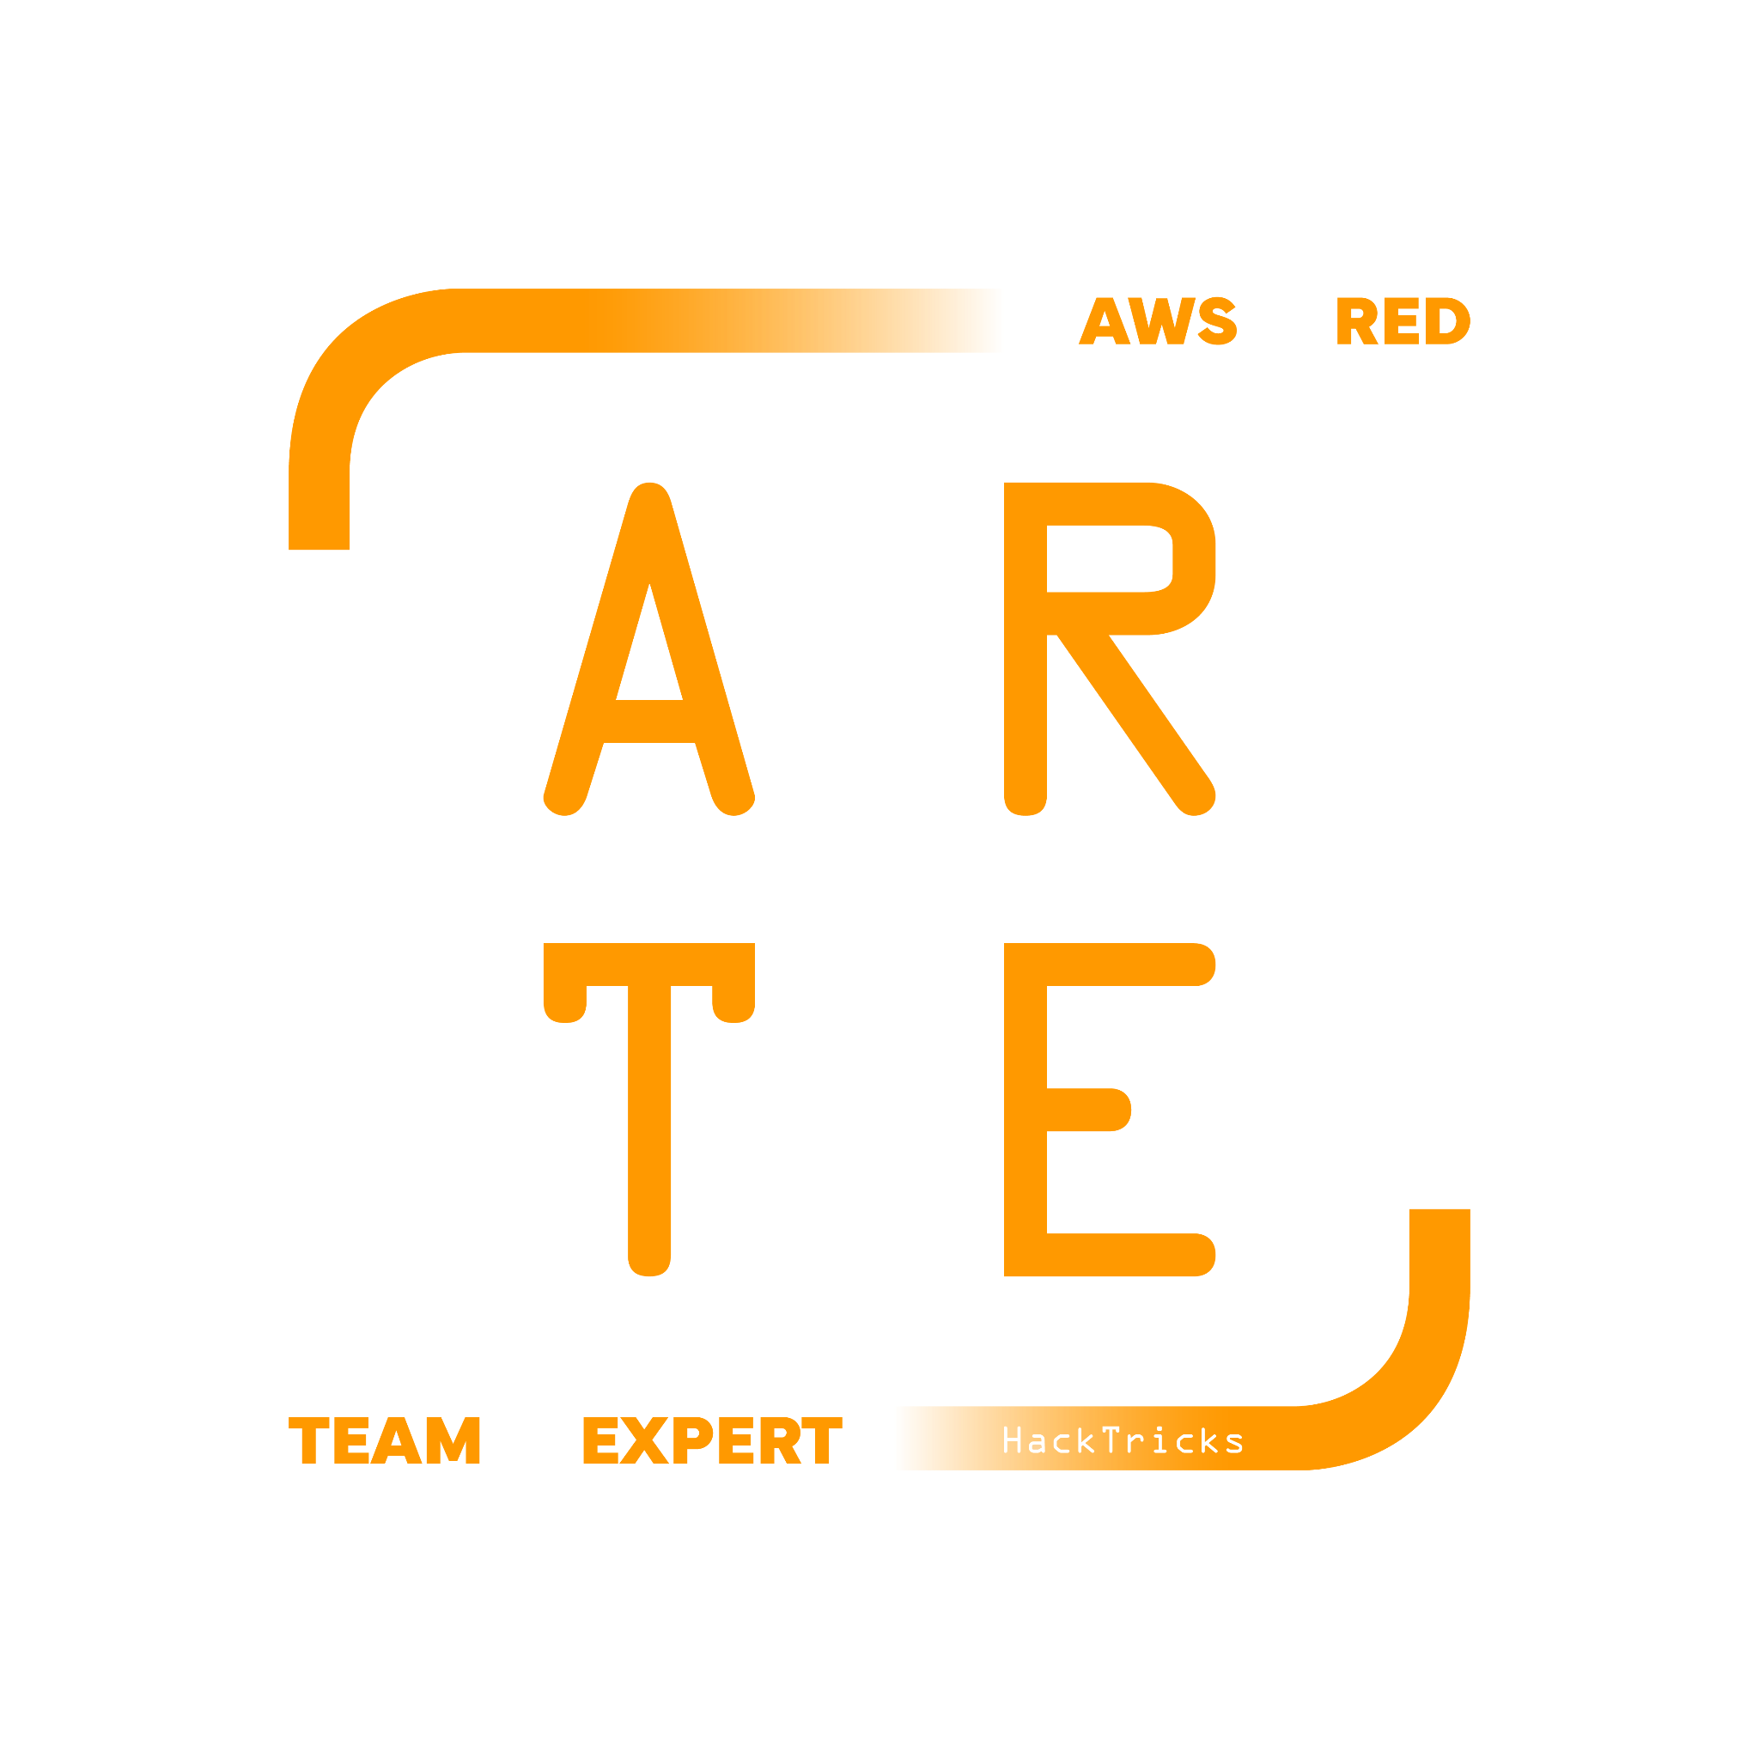
API Gateway
HackTricks Training
https://t.me/CyberFreeCourses

Slide 2
Basic Information - API Gateway
AWS API Gateway is a fully managed service provided by Amazon Web Services (AWS) that allows you to create, publish, maintain, monitor, and secure APIs (Application Programming Interfaces) at any scale. API Gateway acts as a "front door" for applications to access data, business logic, or functionality from your backend services, such as workloads running on Amazon Elastic Compute Cloud (EC2), AWS Lambda, or any web application.
API Gateway enables you to define how requests to your APIs should be handled, and it can create custom API endpoints with specific methods (e.g., GET, POST, PUT, DELETE) and resources. It can also generate client SDKs (Software Development Kits) to make it easier for developers to call your APIs from their applications.
There are 4 types of API Gateways: HTTP API, WebSocket API, REST API & REST API Private.
Main parts of an API Gateway:
Resources: Each method on each path inside the API
Stages: Different versions of the API exposed. The stage is the first part of the path of an API endpoint.
Authorizers: Control access to the API. Can be Lambdas, IAM or Cognito.
Resource Policy: Access to the API can also be controlled with a resource policy.
Moreover, CloudWatch logs, access logs & X-Ray tracing is off by default.
https://t.me/CyberFreeCourses
https://cloud.hacktricks.xyz/pentesting-cloud/aws-security/aws-services/aws-api-gateway-enum

Slide 3
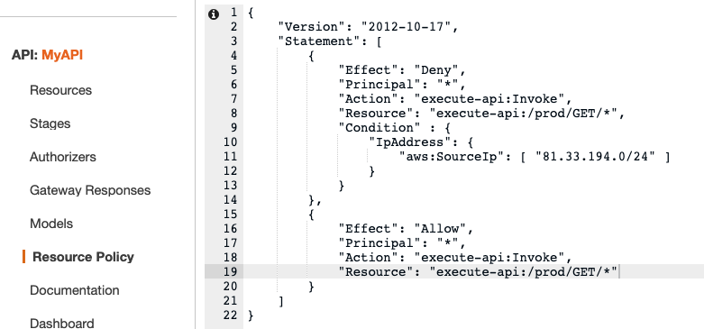
API Gateway - Resource Policies
IAM JSON document that defines permissions for accessing the API. It can be used to impose AWS accounts, IP addresses or other conditions to limit who can access the API.
https://t.me/CyberFreeCourses
https://cloud.hacktricks.xyz/pentesting-cloud/aws-security/aws-services/aws-api-gateway-enum

Slide 4
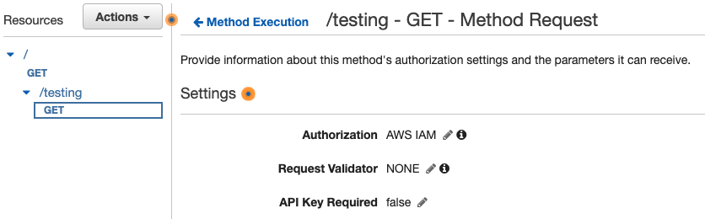
API Gateway - IAM Authorization
It’s also possible to only allow to call an API endpoint to authorizers users via IAM. When this is set you will receive the error {"message":"Missing Authentication Token"} when you try to reach the endpoint without any authorization.
https://t.me/CyberFreeCourses
https://cloud.hacktricks.xyz/pentesting-cloud/aws-security/aws-services/aws-api-gateway-enum

Slide 5
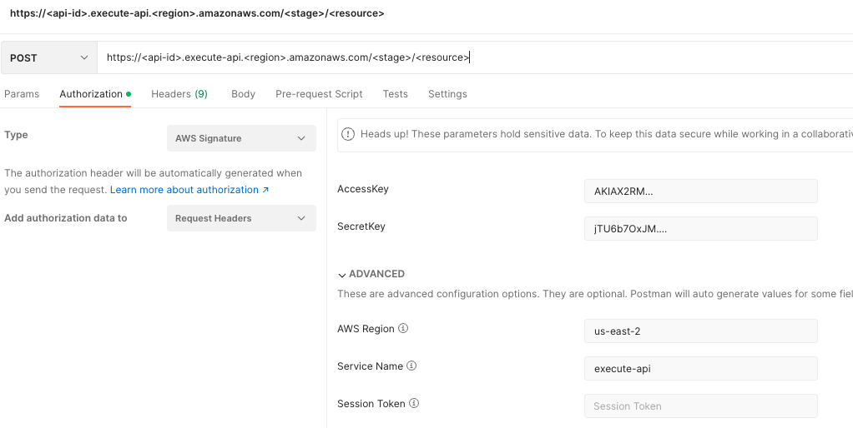
API Gateway - IAM Authorization
If you have a user with the IAM permission execute-api over the API resource you want to call, you could easily create a valid signed request with postman and call it.
https://t.me/CyberFreeCourses
https://cloud.hacktricks.xyz/pentesting-cloud/aws-security/aws-services/aws-api-gateway-enum

Slide 6
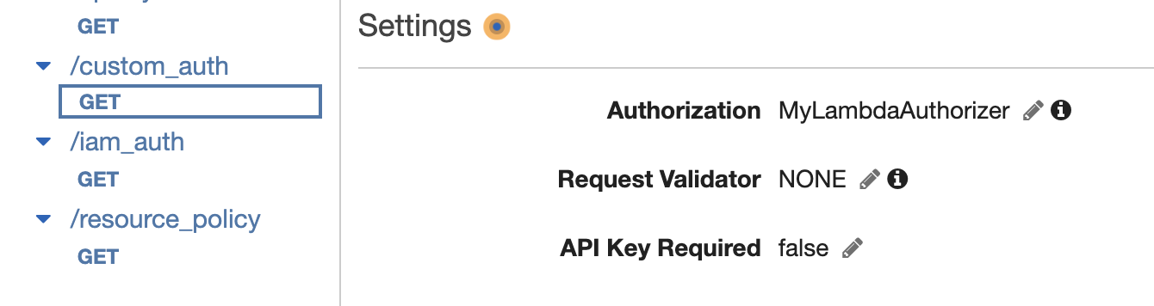
API Gateway - Custom Authorizers
It's possible to use a lambda that based in a given token will return an IAM policy indicating if the user is authorized to call the API endpoint. You can set each resource method that will be using the authoriser.
https://t.me/CyberFreeCourses
https://cloud.hacktricks.xyz/pentesting-cloud/aws-security/aws-services/aws-api-gateway-enum

Slide 7
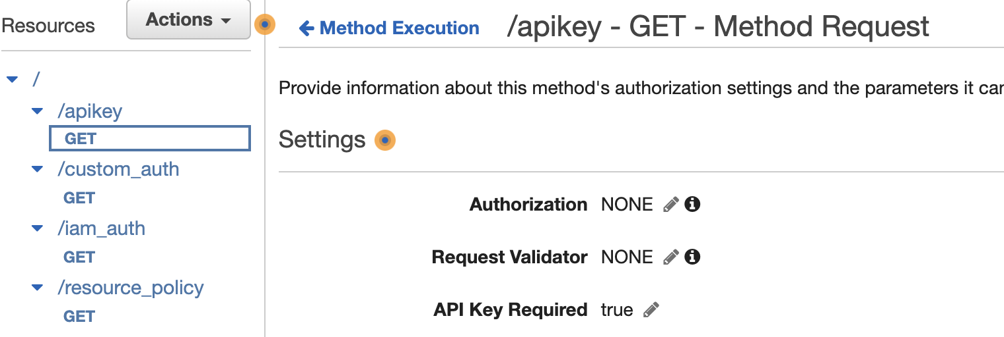
API Gateway - Required API Key
It's possible to set API endpoints that require a valid API key to contact it.
https://t.me/CyberFreeCourses
https://cloud.hacktricks.xyz/pentesting-cloud/aws-security/aws-services/aws-api-gateway-enum

Slide 8
Manual Enumeration
DEMO
# Get generic account info
aws apigateway get-account
# Enumerate APIs
aws apigateway get-rest-apis # This will also show the resource policy (if any)
## Get stages
aws apigateway get-stages --rest-api-id <id>
## Get resources
aws apigateway get-resources --rest-api-id <id>
## Get API resource action per HTTP verb (check authorizers and api key required)
aws apigateway get-method --http-method GET --rest-api-id <api-id> --resource-id <resource-id>
## API authorizers
aws apigateway get-authorizers --rest-api-id <id>
# Get api keys generated
aws apigateway get-api-keys --include-value
https://t.me/CyberFreeCourses
https://cloud.hacktricks.xyz/pentesting-cloud/aws-security/aws-services/aws-api-gateway-enum
Notes:
Show created lambda and how to access via resource policy, IAM auth & custom auth
https://eu-west-1.console.aws.amazon.com/apigateway/home?region=eu-west-1#/apis/dyhqaybh6f/resources/ia0hd8ci43 ## Manual enumeration
aws --profile myadmin apigateway get-rest-apis --region eu-west-1
aws --profile myadmin --region eu-west-1 apigateway get-stages --rest-api-id dyhqaybh6f
aws --profile myadmin --region eu-west-1 apigateway get-resources --rest-api-id dyhqaybh6f
## No Auth required
https://eu-west-1.console.aws.amazon.com/apigateway/home?region=eu-west-1#/apis/dyhqaybh6f/resources/kdhhyg
curl "https://dyhqaybh6f.execute-api.eu-west-1.amazonaws.com/prod/no_auth"
aws --profile myadmin --region eu-west-1 apigateway get-method --http-method GET --rest-api-id dyhqaybh6f --resource-id kdholjszdhyg
## API key
https://eu-west-1.console.aws.amazon.com/apigateway/home?region=eu-west-1#/apis/dyhqaybh6f/stages/prod/resources/~1apikey
curl "https://dyhqaybh6f.execute-api.eu-west-1.amazonaws.com/prod/apikey"
aws --profile myadmin --region eu-west-1 apigateway get-method --http-method GET --rest-api-id dyhqaybh6f --resource-id oljszd
aws --profile myadmin --region eu-west-1 apigateway get-api-keys --include-value
aws --profile myadmin --region eu-west-1 apigateway get-usage-plans
aws --profile myadmin --region eu-west-1 apigateway get-usage-plan-keys --usage-plan-id c52k4t
aws --profile myadmin --region eu-west-1 apigateway get-usage --usage-plan-id c52k4t --start-date 2023-07-01 --end-date 2023-07-20
curl -H "x-api-key: GMwlT02r1C2TWJ0zSicjnaar5vodETrO59acxYro" "https://dyhqaybh6f.execute-api.eu-west-1.amazonaws.com/prod/apikey"
## Resource Policy
https://eu-west-1.console.aws.amazon.com/apigateway/home?region=eu-west-1#/apis/dyhqaybh6f/resources/cc4gal
Policy: https://eu-west-1.console.aws.amazon.com/apigateway/home?region=eu-west-1#/apis/dyhqaybh6f/resource-policy
aws --profile myadmin apigateway get-rest-apis --region eu-west-1
curl "https://dyhqaybh6f.execute-api.eu-west-1.amazonaws.com/prod/resource_policy"
Change resource policy to forbid our current IP address and REDEPLY the api and retry the previous curl
aws --profile myadmin --region eu-west-1 apigateway get-method --http-method GET --rest-api-id dyhqaybh6f --resource-id cc4gal
## IAM Auth
https://eu-west-1.console.aws.amazon.com/apigateway/home?region=eu-west-1#/apis/dyhqaybh6f/stages/prod/resources/~1iam_auth
Go to Postman and show the setting
aws --profile myadmin --region eu-west-1 apigateway get-method --http-method GET --rest-api-id dyhqaybh6f --resource-id 4lbepu
## Custom Auth
https://eu-west-1.console.aws.amazon.com/apigateway/home?region=eu-west-1#/apis/dyhqaybh6f/stages/prod/resources/~1custom_auth/methods/GET
curl "https://dyhqaybh6f.execute-api.eu-west-1.amazonaws.com/prod/custom_auth"
aws --profile myadmin --region eu-west-1 apigateway get-method --http-method GET --rest-api-id dyhqaybh6f --resource-id 2t5dl4
Get auths: aws --profile myadmin --region eu-west-1 apigateway get-authorizers --rest-api-id dyhqaybh6f
Code: https://eu-west-1.console.aws.amazon.com/lambda/home?region=eu-west-1#/functions/MyLambdaAuth?tab=code
curl -H "Authorization: your-secret-token" "https://dyhqaybh6f.execute-api.eu-west-1.amazonaws.com/prod/custom_auth"

Slide 9
Unauth Access
Too wide wildcards
An arn indicating the endpoint that a user can call looks like this: arn:aws:execute-api:region:account-id:<api-id>/<stage>/<METHOD_HTTP_VERB>/<Resource-path>
According to the talk Attack Vectors for APIs Using AWS API Gateway Lambda Authorizers - Alexandre & Leonardo a wildcard in the arn. for example in the <stage> or <method>, won’t stop in the next “/” which could allow to bypass protections.
For example A rule such as arn:aws:execute-apis:sa-east-1:accid:api-id/prod/*/dashboard/* in order to give each user access to /dashboard/user/{username} using any method will give them access to other routes such as /admin/dashboard/createAdmin for example because the wildcard in this case will represent the method +“/admin”.
Policy Injection
In the same talk is explained how if the user input is used in a custom lambda authorizer to generate an IAM policy, an attacker could abuse it to inject extra chars (such as “*” or “.” in the policy) to try to access new endpoints.
https://t.me/CyberFreeCourses
https://cloud.hacktricks.xyz/pentesting-cloud/aws-security/aws-unauthenticated-enum-access/aws-api-gateway-unauthenticated-enum

Slide 10
Post Exploitation
Access unexposed APIs
With enough permissions you could expose an API endpoint in a VPC where you have access (potentially via an EC2 machine), and then contact/exploit the API gateway from it.
Usage plan DoS
API keys might have a maximum use per day/week/Month that an attacker could consume if he manages to obtain the key.
https://t.me/CyberFreeCourses
https://cloud.hacktricks.xyz/pentesting-cloud/aws-security/aws-post-exploitation/aws-api-gateway-post-exploitation

Slide 11
Privilege Escalation
apigateway:POST
Generate API keys
apigateway:GET
Get generated API keys
apigateway:UpdateRestApiPolicy, apigateway:PATCH
Update resource policy
https://t.me/CyberFreeCourses
https://cloud.hacktricks.xyz/pentesting-cloud/aws-security/aws-privilege-escalation/aws-apigateway-privesc

Slide 12
Persistence
Modify or delete resource policy
Modify or delete IAM Auths
Modify or delete Custom Lambda Auths
Leak or create API keys
https://t.me/CyberFreeCourses
https://cloud.hacktricks.xyz/pentesting-cloud/aws-security/aws-persistence/aws-api-gateway-persistence

